Slide 1

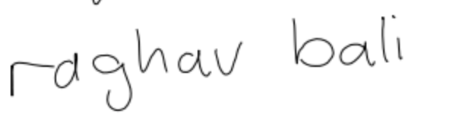
Synthetic Handwritten Text Data Generation using Deep Learning

Slide 2
About Me
Senior Data Scientist
Author

Slide 3
Slides & Code
Github: https://github.com/raghavbali/handwritten_text_dhs_av_2019

Slide 4
Agenda
Why Generate Handwriting
Overall Setup
Exploring the dataset
Quick Demo
Network Architecture
Gaussians
Training & Prediction
Experiments
References

Slide 5
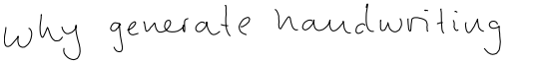
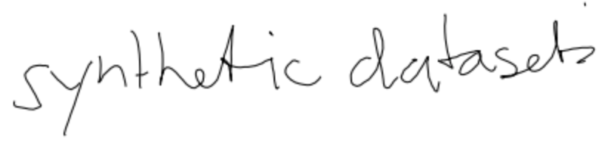
To Understand Data Generation Processes This has multiple advantages such as :
capability to model more complex problems (like speech synthesis)
capability to design models which generalize better

Slide 6
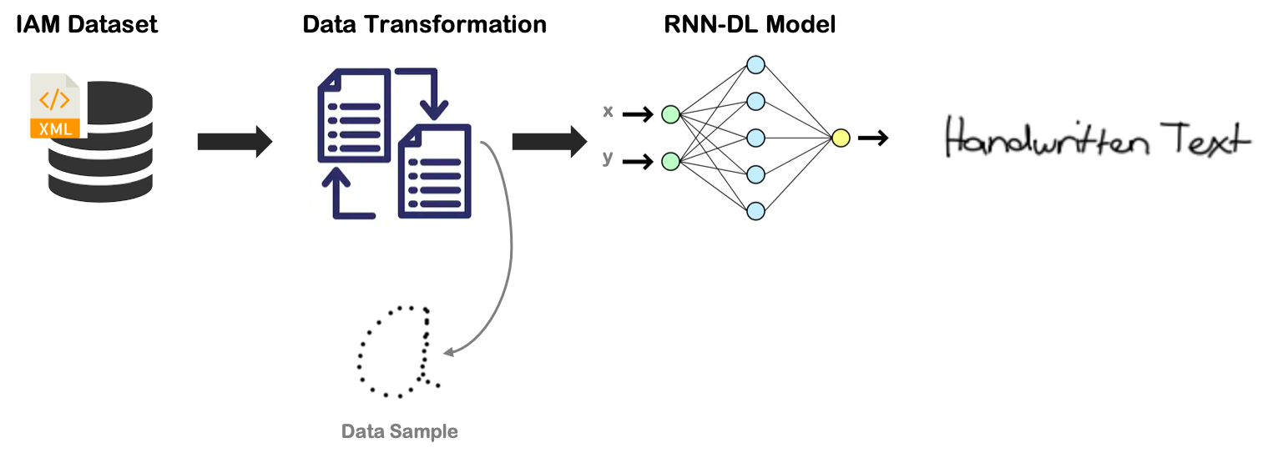
Overall Setup

Slide 7
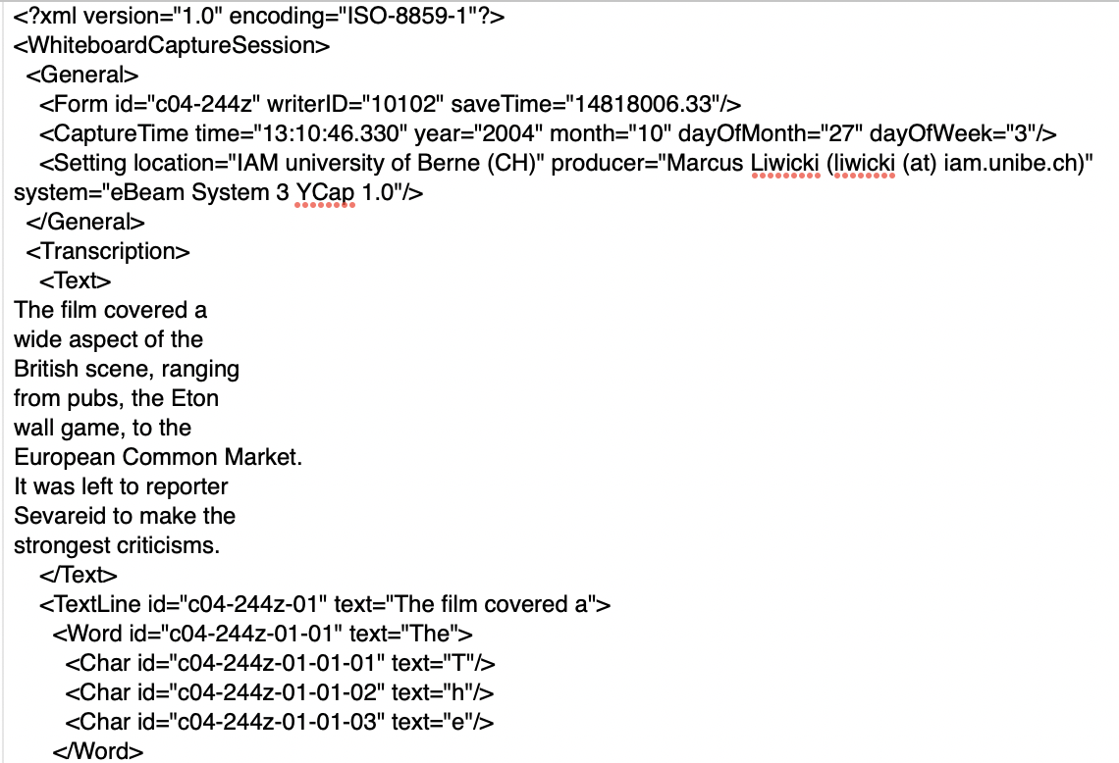
Exploring the Dataset
Pen Trajectories (x,y) coordinates
IAM Online Handwriting Dataset :
10k Samples
200+ Contributors
Unconstrainted Written Samples

Slide 8
Quick Demo
Text to be Generated : A Move to Stop Mr. Gaitskell
[x,y]: [207,371]
X
Y
White Board

Slide 9

Quick Demo
Text to be Generated : A Move to Stop Mr. Gaitskell
[x,y]: [207,371]
X
Y
White Board

Slide 10
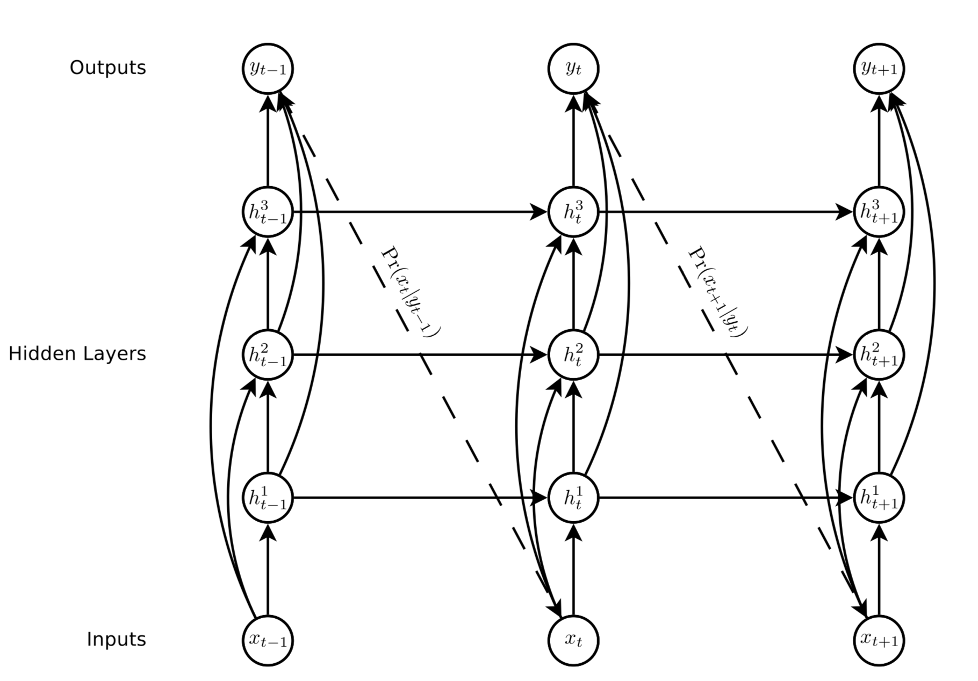
Network Architecture
LSTMs
Skip Connections
Mixture Density Networks
Image Source: Generating Sequences With Recurrent Neural Networks

Slide 11
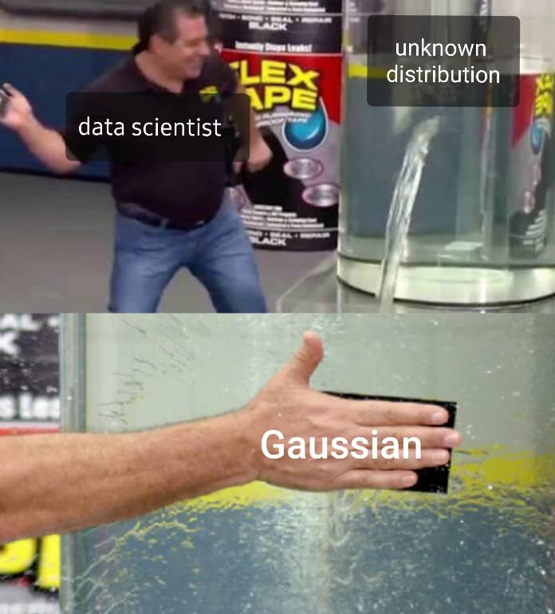
Gaussian Distributions

Slide 12
Gaussian Distributions
Also known as :
Normal Distribution
Bell Curve
Central Limit Theorem?
Notation:
Probability Density:

Slide 13
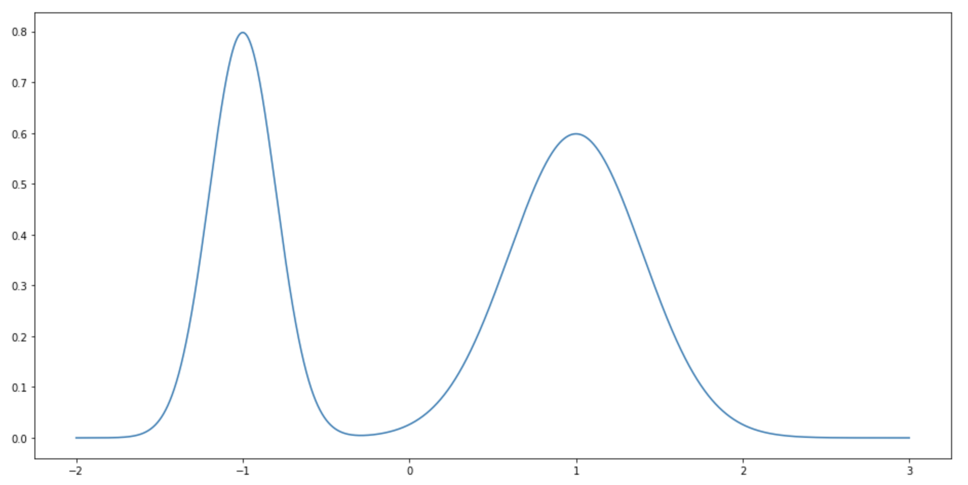
Gaussian Mixtures

Slide 14
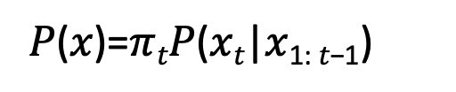
Training & Prediction
x₂,y₂
x₃,y₃
x₄,y₄
x_{n},y_{n}
RNN Network
RNN Network
RNN Network
RNN Network
Training
x₁,y₁
x₂,y₂
x₃,y₃
X_{n-1},y_{n-1}
Loss
𝑃(𝑥)=$π$_{𝑡}𝑃(𝑥_{𝑡}|𝑥_{1: 𝑡−1})
x`₂,y`₂
x`₃,y`₃
x`₄,y`₄
x`_{n},y`_{n}
RNN Network
RNN Network
RNN Network
RNN Network
Prediction
x₁,y₁
x₂,y₂
x₃,y₃
X_{n-1},y_{n-1}

Slide 15
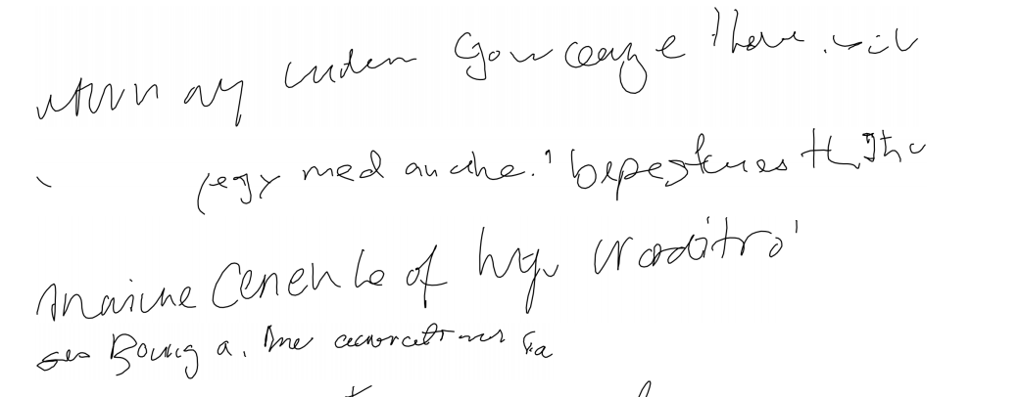
Experiments
Online Experiments
Less Comprehensive Characters/Words
Inconsistent Handwriting Style
Some Characters make sense
Image Source: Generating Sequences With Recurrent Neural Networks

Slide 16
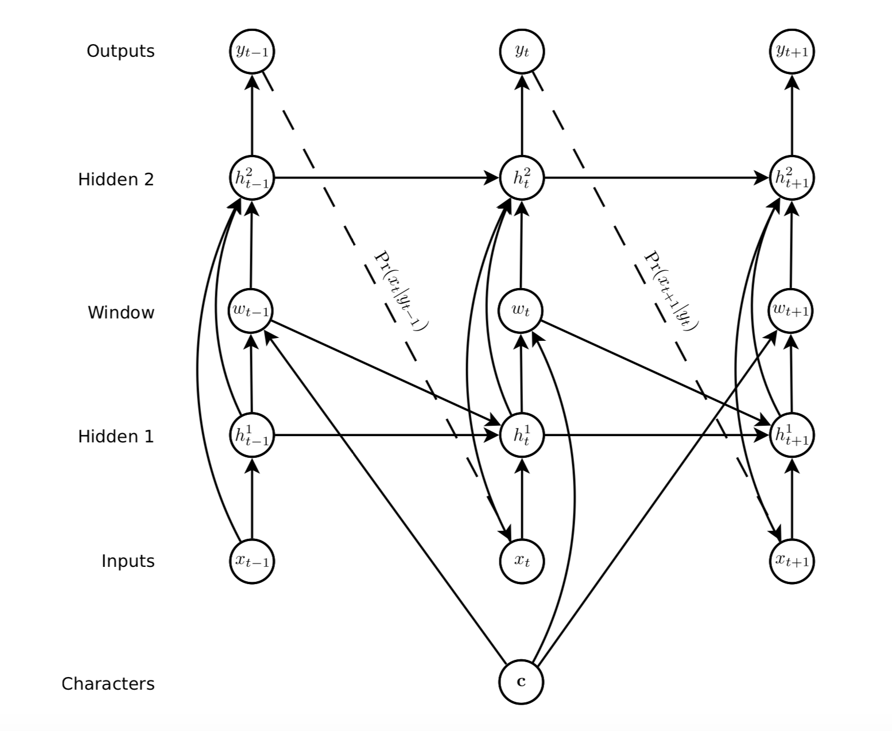
Experiments
Handwriting Synthesis: Tell model what to write
Image Source: Generating Sequences With Recurrent Neural Networks

Slide 17
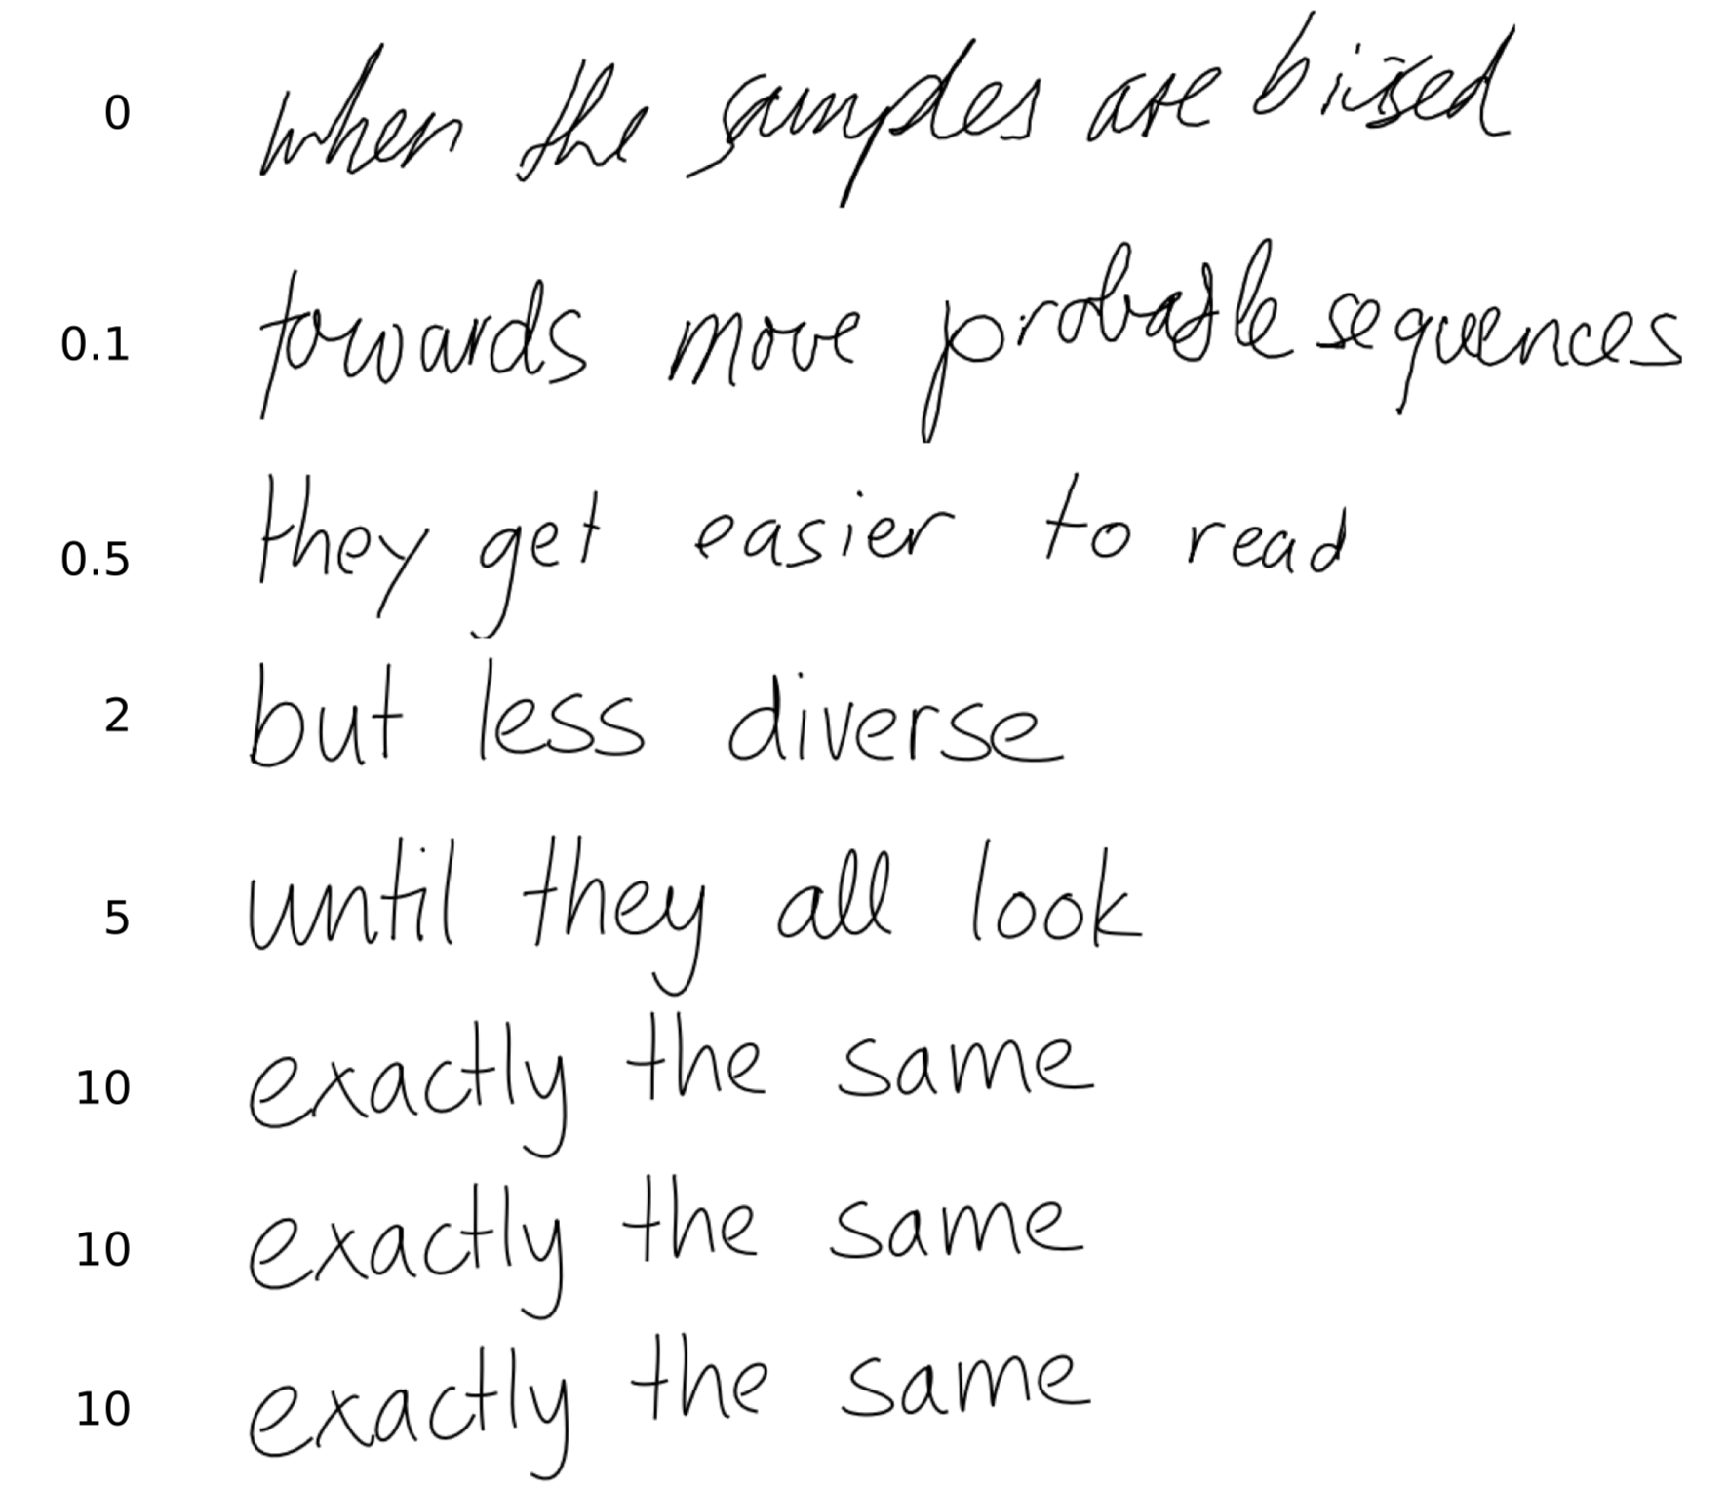
Experiments
Handwriting Synthesis: Tell model what to write
Biased Experiments
Bias the variance of Gaussians for style consistency
Image Source: Generating Sequences With Recurrent Neural Networks

Slide 18
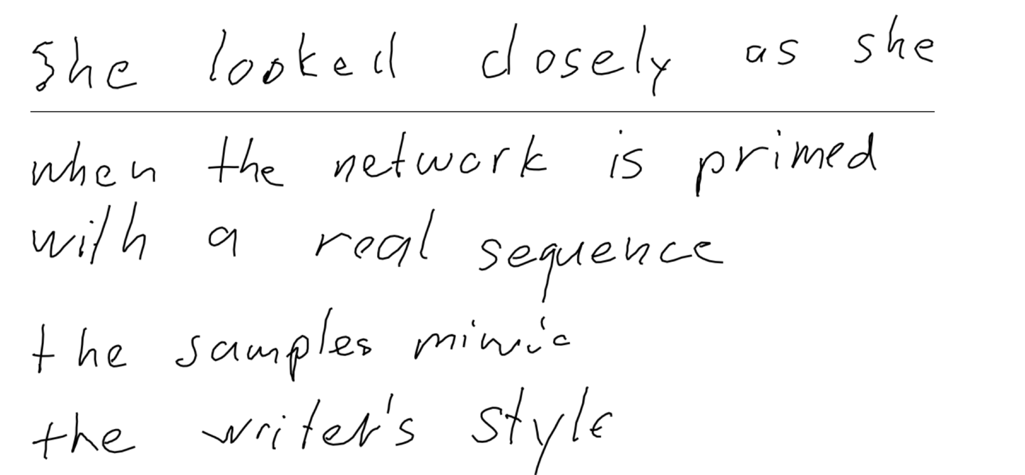
Experiments
Handwriting Synthesis: Tell model what to write
Primed Experiments
Bias network towards specific writing styles
Image Source: Generating Sequences With Recurrent Neural Networks

Slide 19
References
Generating Sequences with RNNs, Alex Graves
Neural Machine Translation by Jointly Learning to Align and Translate, Bengio et al
Attention Is All You Need, Vaswani et al
Handwriting Generation Demo
Chapter3, Hands on Transfer Learning, Dipanjan Sarkar, Raghav Bali, et al
LSTM, Chris' blog
Four Experiments in Handwriting with a Neural Network, distlill.pub
Mixture Density Networks, Hardmaru/Otoro's Blog
Keras MDN
Tensorflow Probability

Slide 20

Thank you!

